Slide 1

Stock Market Prediction with Sentiment Analysis
By Manuel Garcia Acosta, Papa Fall, and Vivswan Shah

Slide 2
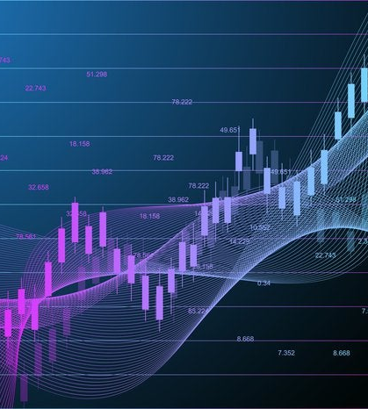
Introduction
The stock market is an equity market where buyers and sellers are able to trade shares of stocks. It allows individuals to invest their capital and take part in a country’s economic growth.
Stock markets are important indicators of a nation’s economic strength, because an increase in overall stock value has a direct relationship with an increase in company investments.
With the chance of possible positive returns one of the main concerns of stock market investors is stock return predictability.
Notes:
Motivation

Slide 3
Stock Market Predictability
There is a lot of facts, data, and statistics readily available for investors everyday. With all this data investors have options in finding models for return predictability.
Assessing this predictability requires making predictions for positive net returns based on large sets of conditional information, which has been proven to not be possible through conventional statistics.
Therefore, machine learning models have gained popularity in the financial sector, with several machine learning models being used to study stock returns. These models function by using past stock returns as features and output future stock returns.

Slide 4
Project Objective
The primary objective of our project was to use machine learning to predict daily stock returns of the US stock market based on a selection of companies.
For our project we decided on building a neural network that uses stock data from the years of 2014-2019. With the plan being that our model will be able to predict the next day’s returns with a threshold of 0.
The features used by our model would be the (lagged entries) past returns from each stock, while using the Nevasalmi methodology which states that lag lengths beyond ten days are uninformative.
To test the performance of our model, we will be using the accuracy classification for each model.

Slide 5
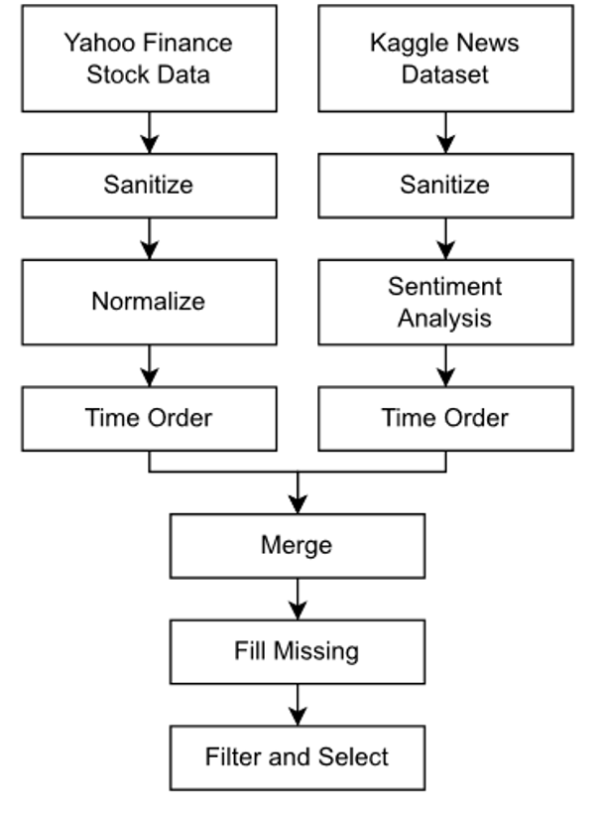
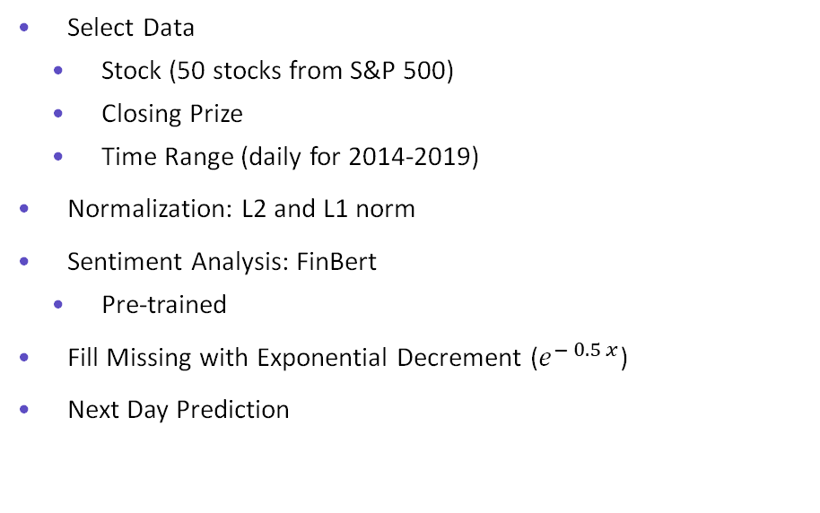
Preparations
Select Data
Stock (50 stocks from S&P 500)
Closing Prize
Time Range (daily for 2014-2019)
Normalization: L2 and L1 norm
Sentiment Analysis: FinBert
Pre-trained
Fill Missing with Exponential Decrement ($e^{− 0.5 x}$)
Next Day Prediction
https://www.kaggle.com/datasets/miguelaenlle/massive-stock-news-analysis-db-for-nlpbacktests
https://huggingface.co/ProsusAI/finbert?text=hi

Slide 6
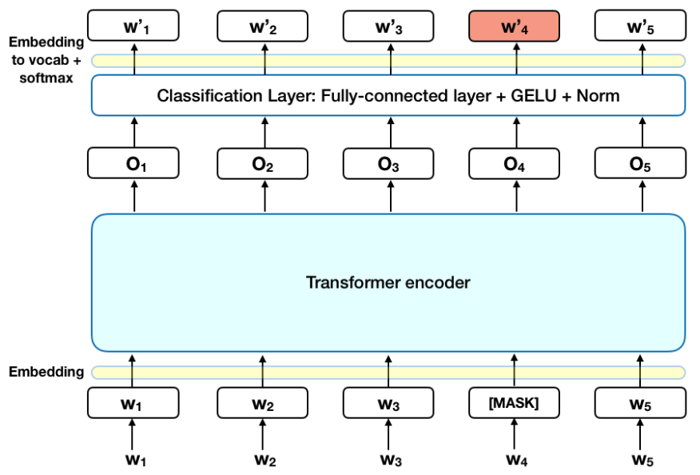
Sentiment Analysis Model (FinBert)
BERT (Bidirectional Encoder Representations from Transformers)
Fast
Fine-Tunable
FinBert
Sentiment Analysis
Trained on Financial Data
Results
Positive
Negative
Neutral
Example: Link
Araci, Dogu. "Finbert: Financial sentiment analysis with pre-trained language models." arXiv preprint arXiv:1908.10063 (2019).
Sousa, Matheus Gomes, et al. "BERT for stock market sentiment analysis." 2019 IEEE 31st International Conference on Tools with Artificial Intelligence (ICTAI). IEEE, 2019.

Slide 7
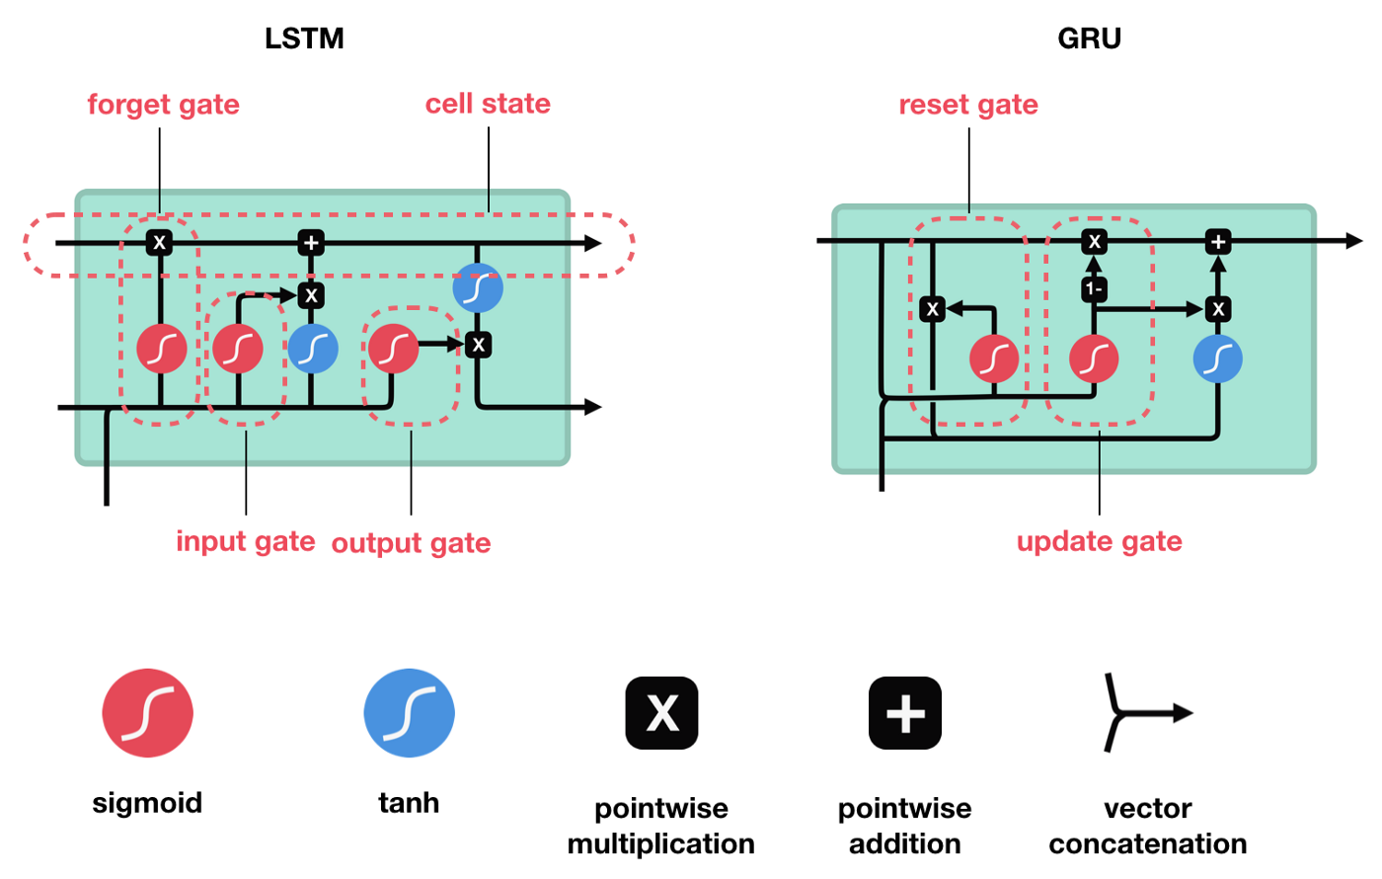
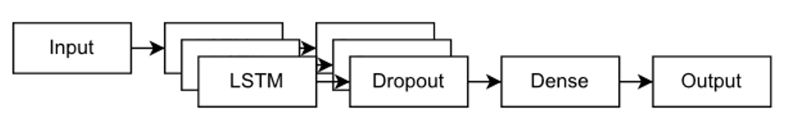
Stock Market Analysis Model (LSTM)
LSTM (Long Short-Term Memory)
Why?
Time-Series Data
Non Fine-Tunable
Multiple LSTM layers
Dropout rate of 33%
Moghar, Adil, and Mhamed Hamiche. "Stock market prediction using LSTM recurrent neural network." Procedia Computer Science 170 (2020): 1168-1173.
Thakkar, Ankit, and Kinjal Chaudhari. "A comprehensive survey on deep neural networks for stock market: the need, challenges, and future directions." Expert Systems with Applications 177 (2021): 114800.

Slide 8
Training/Testing Process
Training and Testing Split (0.8%)
Time-Step: 50 days
Optimizer: Adam
Loss: Mean-Squared Loss
Batch Size: 64
Hyper-Parameters:
Number of LSTM Layers: 1-4
Sentiment: True and False
Epochs: 50, 100 and 150
https://towardsdatascience.com/lstm-time-series-forecasting-predicting-stock-prices-using-an-lstm-model-6223e9644a2f

Slide 9
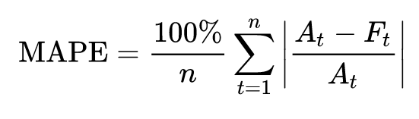
Results
Test error was measured using the Mean Absolute Percentage Error (MAPE).
Training with L1 results in effectively no learning.
L2 normalization.
Models with 3 LSTM layers achieved the smallest errors.
Models with sentiment analysis had more variation in the error.
Networks with more epochs performed better (until they started overfitting).
Let's look at some of the best and worst models.

Slide 10
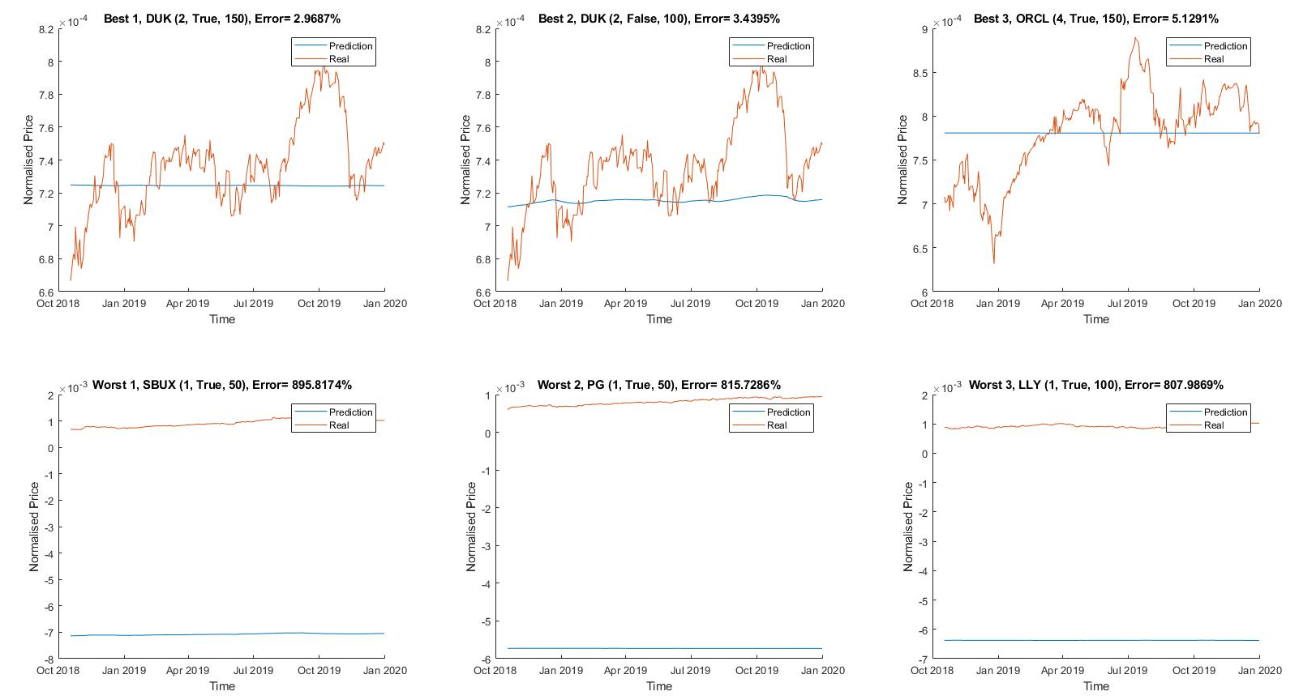
Results (L1 Norm)

Slide 11
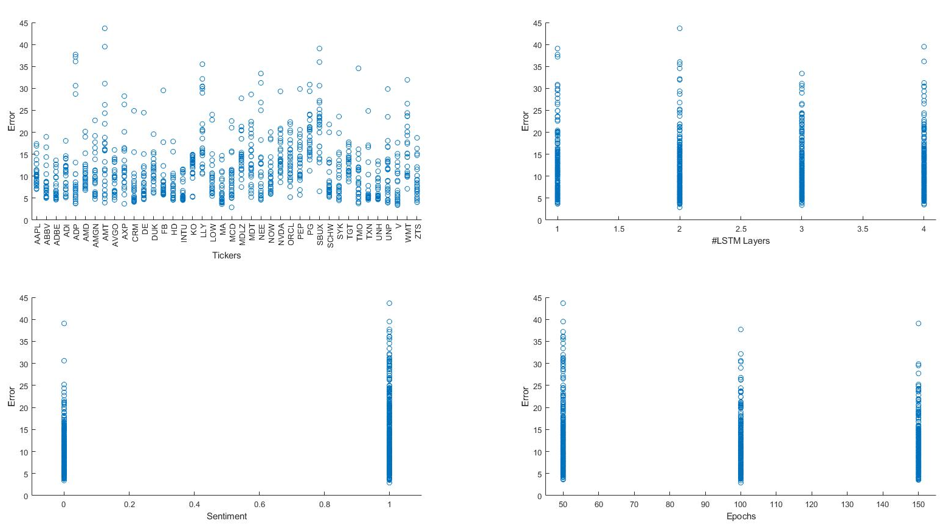
Results (L2 Norm)

Slide 12
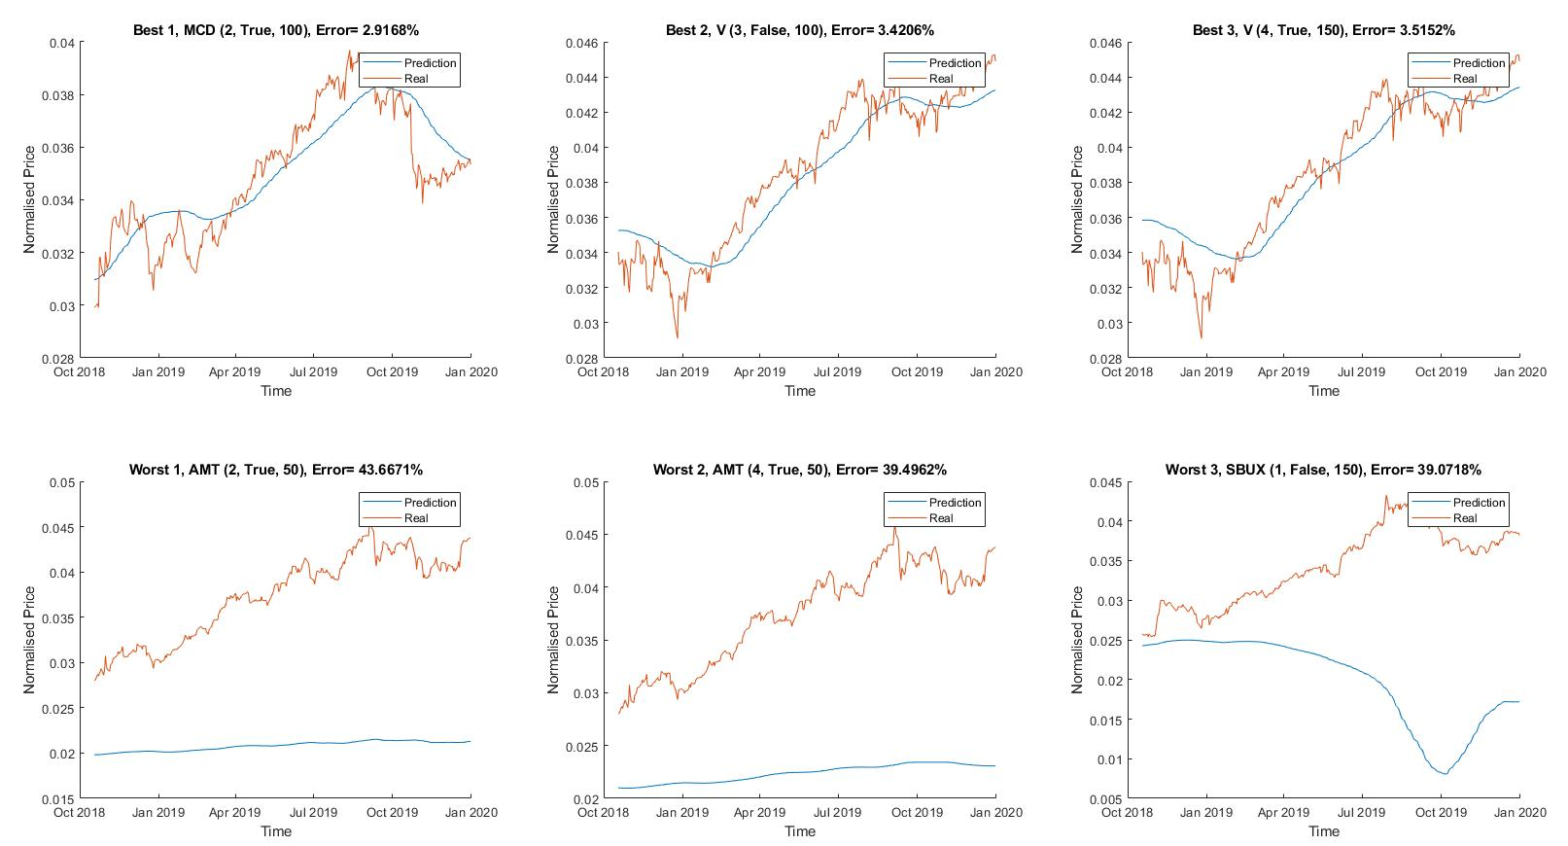
Results (L2 Norm)

Slide 13
Conclusion, challenges and future directions
LSTM networks provide a promising approach to analyze stock market trends.
Training/testing of these models can be quite time consuming, since it requires fine tuning hyperparameters among other conditions:
Loss function: RMSE, MSE, Mean Absolute Error (MAE) and MAPE have been used in previous publications.
Data normalization. L1, L2, Min-Max, etc.
Current dataset for news data was obtained from kaggle. A larger dataset from a news dedicated API (e.g. mediastack, The New York Times) might improve results using sentiment analysis (FinBERT).
We did not consider features like the split of a stock, this could be added to the model in future studies.

Slide 14
Thank you Any Questions?

